Slide 1
Respiratory Illness

Slide 2
Introduction Types of respiratory illness commonly seen: COPD Asthma Less commonly seen: Tuberculosis Crack Lung Management Referrals

Slide 3
COPD
Chronic Obstructive Pulmonary Disease

Slide 4
Chronic Obstructive Pulmonary Disease
Rates of smoking heroin have risen, with a detrimental effect on lungs – developing COPD earlier
Main cause of COPD is smoking
2% of the population are estimated to have COPD
Approximately 50% of people who smoke heroin have COPD
Arch screens all patients for COPD at the new patient health check, and monitors regularly

Slide 5
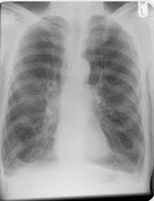
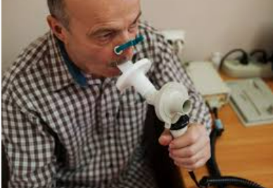
Chronic Obstructive Pulmonary Disease
Signs of COPD
Cough with mucus that persists for long periods of time.
Difficulty taking a deep breath.
Shortness of breath with mild exercise (like walking or using the stairs).
Shortness of breath performing regular daily activities.
Wheezing.
Tests
History
Spirometry (checking for obstructions in the airways)
Chest X-ray

Slide 6
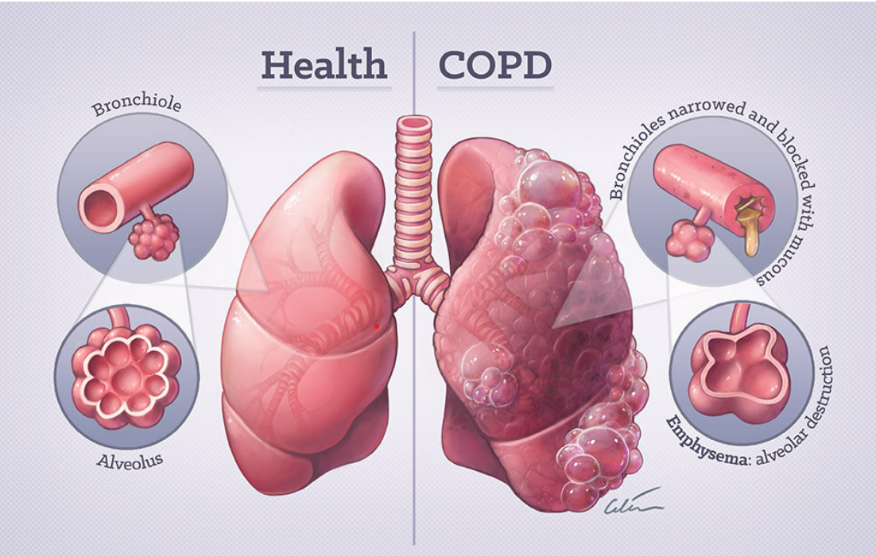

Slide 7
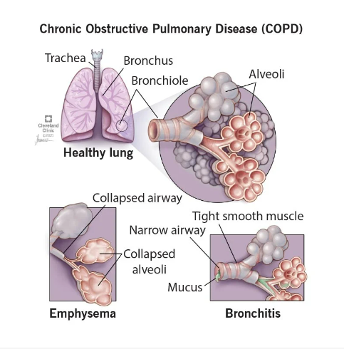
Two main things happening with COPD:
Emphysema (collapsed airways → breathlessness)
Bronchitis (Mucus and tight smooth muscle → coughing, lots of mucus)

Slide 8
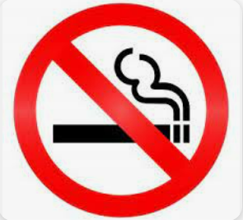
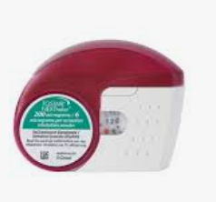
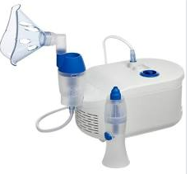
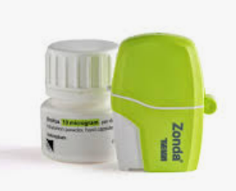
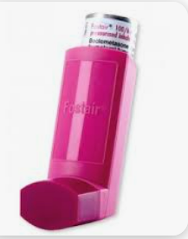
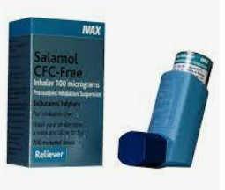
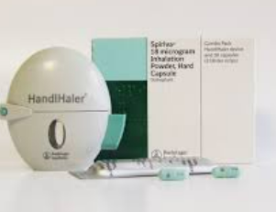
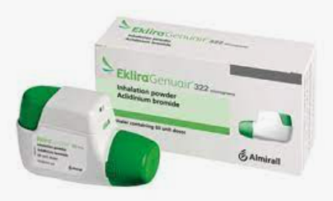
COPD is irreversible
Management
Stop smoking
Inhalers
Nebulisers
Pulmonary rehab: ways to improve breathlessness, clear mucus, manage exercise
Oxygen therapy: highly flammable, so may not be available to all
A lot of inhalers take a bit of time to build up and work, bringing inflammation down over a few weeks
Quick effect, not long lasting. If needed very often, may need to switch to a different inhaler

Slide 9
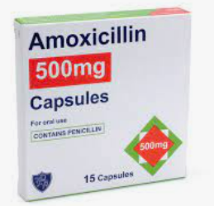
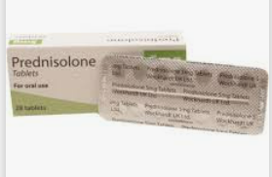
COPD: advanced management
Rescue Packs: COPD makes it more likely to contract chest infections (“exacerbations”) → if patients are familiar with the symptoms, the patient might be given medicines to start taking before they’ve seen a health professional.
Home oxygen… but only if not smoking.
End of life care: Martlets Hospice

Slide 10
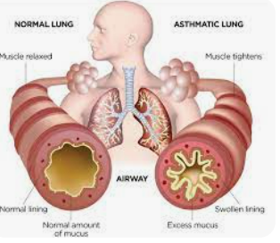
Symptoms:
Difficulty breathing
Wheezing
Sleep problems
Chest pain
Frequent coughing
Allergies
Feeling tired
Triggers:
Pollution
Smoking
Chemicals
Genetics
Dust
Viruses
Asthma: airways in lungs become constricted and tightened, excess mucus produced.

Slide 11
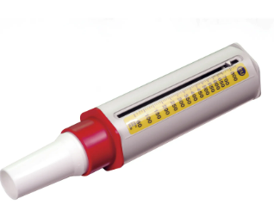
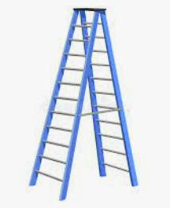
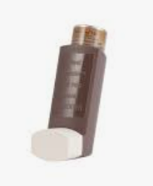
Asthma: managed with stepwise approach
Peak flow: monitoring progress/decline
Stop smoking
Inhalers
Nebulisers
Oxygen therapy
Step 3: Nebuliser. Rescue/emergency treatment in case of asthma attack
Step 2: steroid inhalers: bring down inflammation inside airways. Take a few weeks to start working, provide longer term benefits
Step 1: blue inhaler, relaxes smooth muscle around airways. Lasts about 15 mins

Slide 12
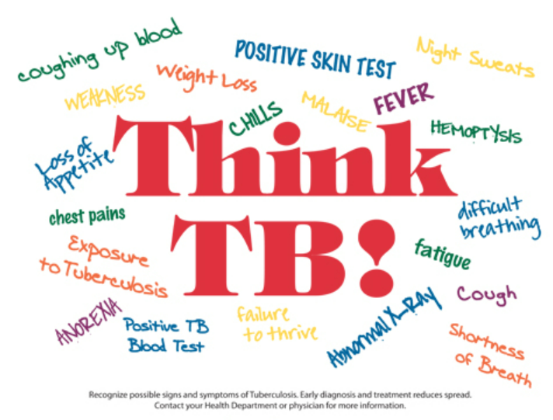
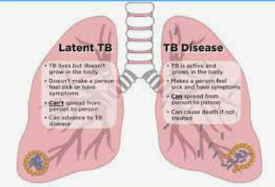
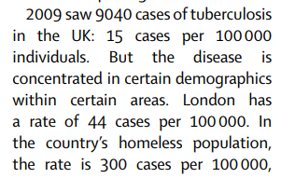
Tuberculosis
Active TB Disease
Have the germ and it is active (multiplying)
Are unwell
Are infectious
Need treatment
Latent TB
Have the germ but not active
Not unwell
Not Infectious
May need treatment
There have been cases of active TB amongst people facing homelessness in Brighton in the last 12 months

Slide 13
Tuberculosis: infections
Tuberculosis is a bacterial infection
Latent TB: no infection risk to others, patient may need treatment to contain the disease
Active TB: a patient with active TB is infectious – infection spreads through inhaling tiny droplets from coughs or sneezes. If contact with someone with active TB, visit your GP for a blood test and skin test to check if you have picked it up.

Slide 14
Other respiratory illnesses
Crack Lung
Happens 24-48 hours after smoking crack: smallest airways (alveoli – see COPD graphic) haemorrhage and collapse. Blood clots in lungs, extreme difficulty breathing. May be coughing up blood. Need to go to hospital, emergency treatment.
HIV: bacterial pneumonia
If HIV + and not managing antiretrovirals well, will have a poor immune system and be prone to chest infections. Need to be seen for treatment with antibiotics as soon as possible.

Slide 15
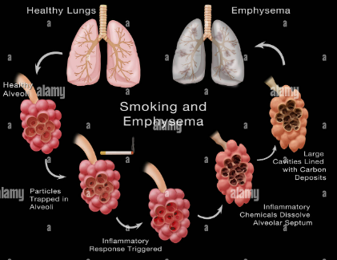
Smoking Lung damage
Smoking: progressive damage to alveoli, these die off, so they can’t get oxygen into the bloodstream → breathlessness → emphysema
Stop smoking therapies
Arch offers 12 week stop smoking course: nicotine replacement therapy. Products available on prescription, so may be free of charge.
Nicotine patches
Inhalators
Gum
Vapes?

Slide 16
Referrals
What care, where?
Arch, or other GP
Community Nursing team
Palliative care team (Martlets)
Respiratory Service
Hospital based respiratory teams

Slide 17
Referrals in Brighton and Hove
What care, where?
Arch, or other GP: all GPs have nurses looking after respiratory patients
Community Nursing team
Palliative care team (Martlets)
Community Respiratory Service: looking after patients with COPD, will visit at home
Hospital based respiratory teams

